Slide 1
Self Driving Car Game
Minor Project - I
Roll No. : 14BIT021, 14BIT054

Slide 2
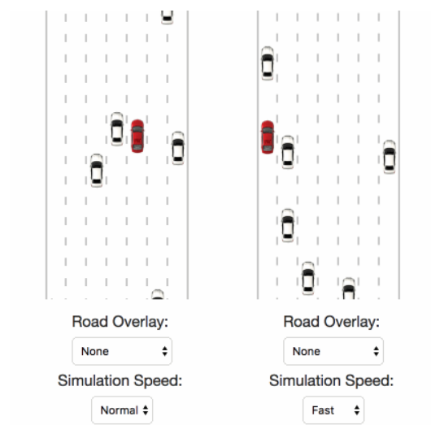
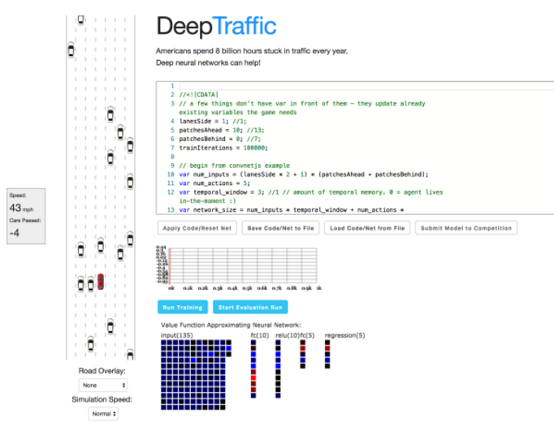
Inspiration - MIT Deep Learning for Self-Driving Cars

Slide 3
Overview
Our project is a gamified simulation of typical highway traffic. We aim to train a neural network that performs well on high traffic roads.
We control one car in the beginning and learn how to navigate efficiently to go as fast as possible.
We can control the basic functionalities - accelerate/slow down or change lanes.
Our aim is to do so, if that is possible, without crashing into other cars.
The way user plays and trains is recorded and lane knowledge is imparted to it in order to detect other traffic in the vicinity and avoid collision and increase maximum reward gain by smartly changing lanes and incrementing its output speed.

Slide 4
Algorithms to Use
We have the general ideology to follow in the footsteps of MIT and learn and try to implement a CNN algorithm over the project.
Input - Lane knowledge and traffic collision rectangles
Output - Direction (Left, Right, Straight), Speed (increase, decrease)
Proposed layer of network - 2 to 3
Use Tensorflow libraries to train and fit data.
Projects on lane follow have been done via genetic algorithms in the past so research on that area is also being carried out, if proved to be easy to implement and efficient with the current problem statement.

Slide 5
Work Till Now
Developed game GUI using Pygame, a cross-platform set of Python modules designed for writing 2D/3D graphical games. It includes computer graphics and sound libraries designed to be used with the Python environment.
The player enters the game by entering his/her name.
The player car as well as other traffic cars are spawned in the game randomly using random and thread package libraries.

Slide 6
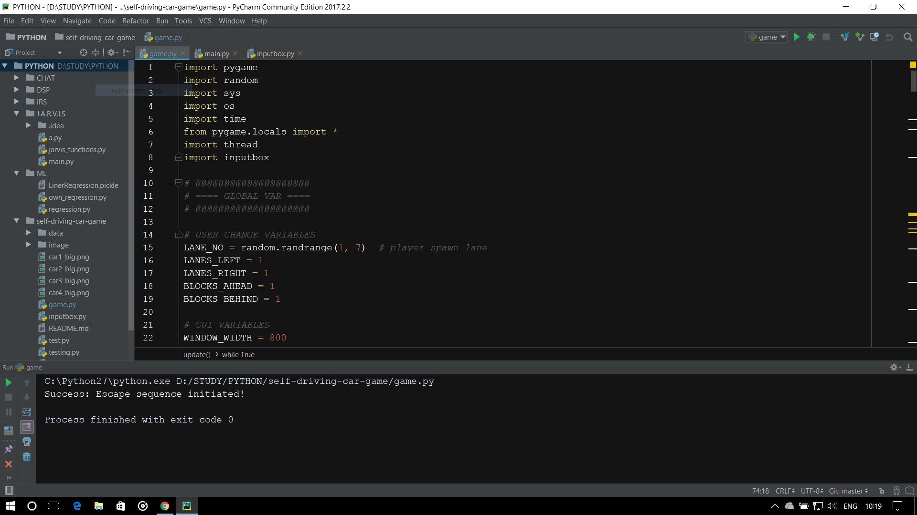
CODE (game.py)
Language : Python
IDE : PyCharm

Slide 7
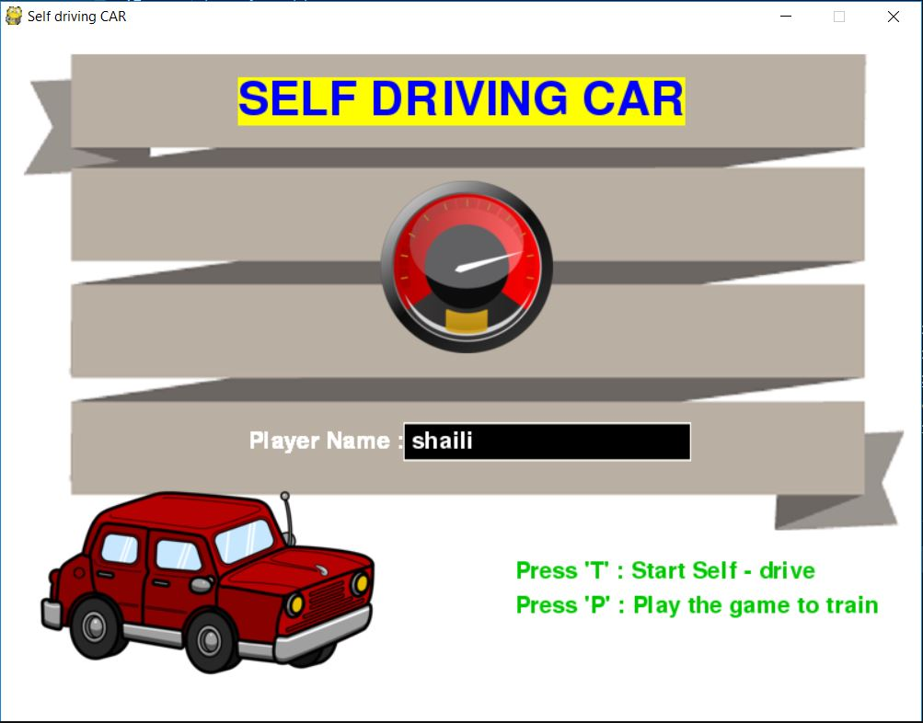
Initial Game Page
Menu
Player Name
Option to train or test

Slide 8
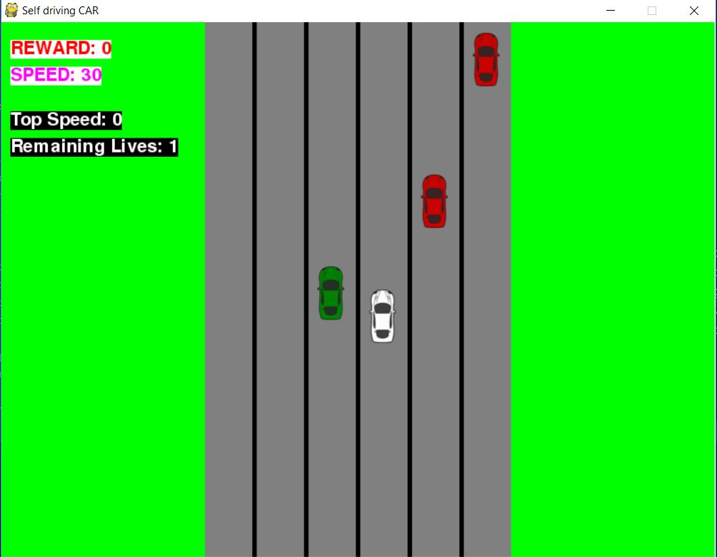
Self - train
Hard-coded
Randomness in both traffic and player

Slide 9
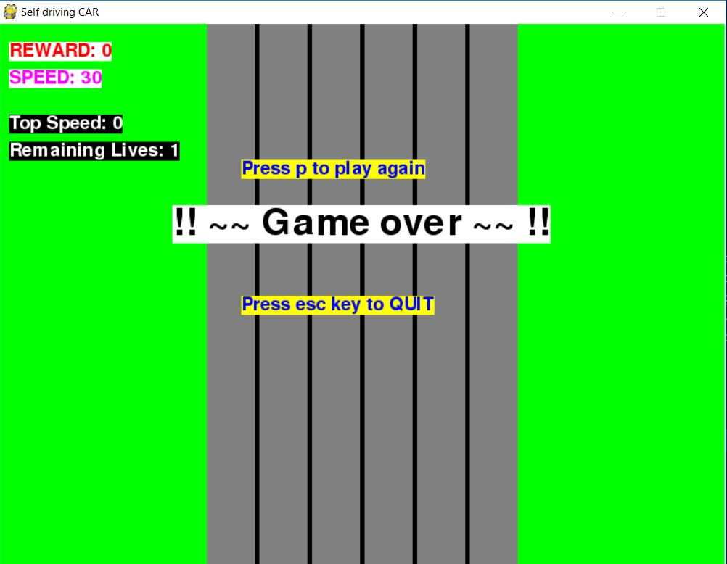
Game Over
Exit Menu
Final top speed noted in a file
Option to play again

Slide 10
END

